Slide 1


ABS-CS Transfer Guide
May 20, 2020

Slide 2

What is ABS?
What is ABS?
ABS stands for Adorama Business Solutions.
Who is ABS?
The ABS groups consists of the following team:
Federal Sales
Pro Services Sales
School Sales
EDU Sales
ABS-CS

Slide 3
What is ABS?
How do I know that it’s an ABS order?
Check if there is a PO number
Check the salesman who placed the order
Check if the payment is under OA.
***Some Corporate/Pro orders uses CC payments and do not have credit limits.
What is a Federal Order?
GSA purchases are expenditures on goods by the Federal, State and local governments.
Federal - United State of America
State - NY, NJ
Local - Municipal

Slide 4
What is ABS?
What is a Pro Services Order?
These are orders made by different industrial, commercial, private companies.
FOX NETWORKS GROUP
What is the difference between School and EDU?
EDU
Orders placed by student and educators
Orders are placed online - 603
No PO numbers
School
Orders are for schools
Orders have PO numbers.
Notes:
Cust# 2492291- Fed

Slide 5
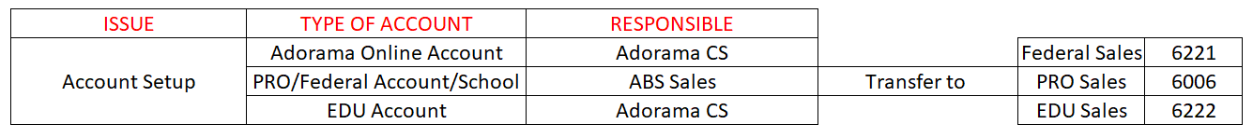
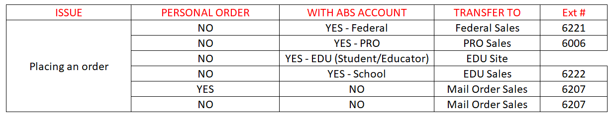
What is ABS?
How do I know that I need to transfer the call?

Slide 6
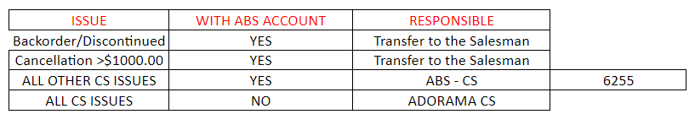
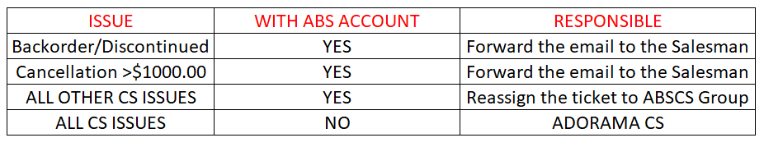
What is ABS?
How do I know that I need to transfer the call?
Where should I transfer the ticket if the CS emailed?

Slide 7
What is AR?
What is AR?
AR stands for Account Receivables.
AR oversees the collection of payments for all ABS order.
Follow-up with them to settle their outstanding overdue balance.
They are also responsible in sending invoices for ABS orders.

Slide 8
What is AR?
What is the difference between an AR invoice and a Regular invoice?
AR Invoice
This is normally being requested by an accounting personnel.
Statement of Account
Specific Invoice - unpaid
Specific Invoice – paid
Send an email to jazze@adorama.com
Regular Invoice
This is normally being requested by the customer.
This can be sent to a regular order.
This can be used as a proof of purchase.
This serves as a receipt.

Slide 9
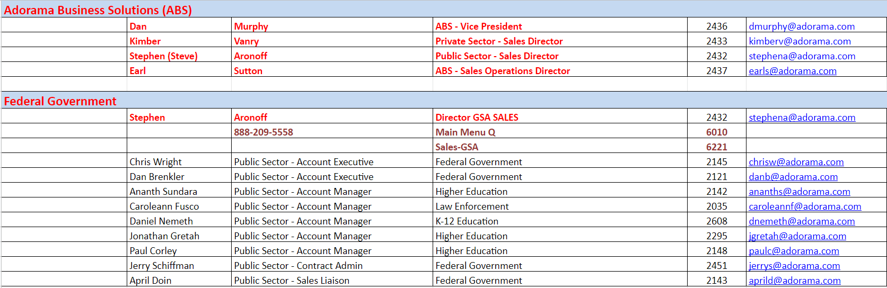
Who are the ABS Sales Team?

Slide 10
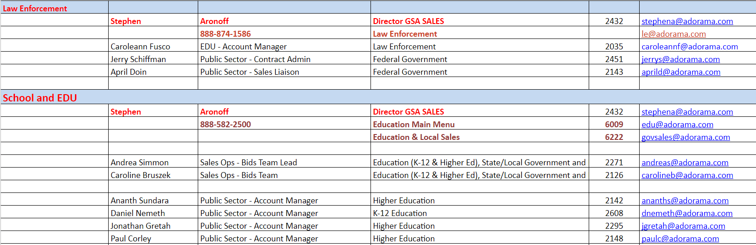
Who are the ABS Sales Team?

Slide 11
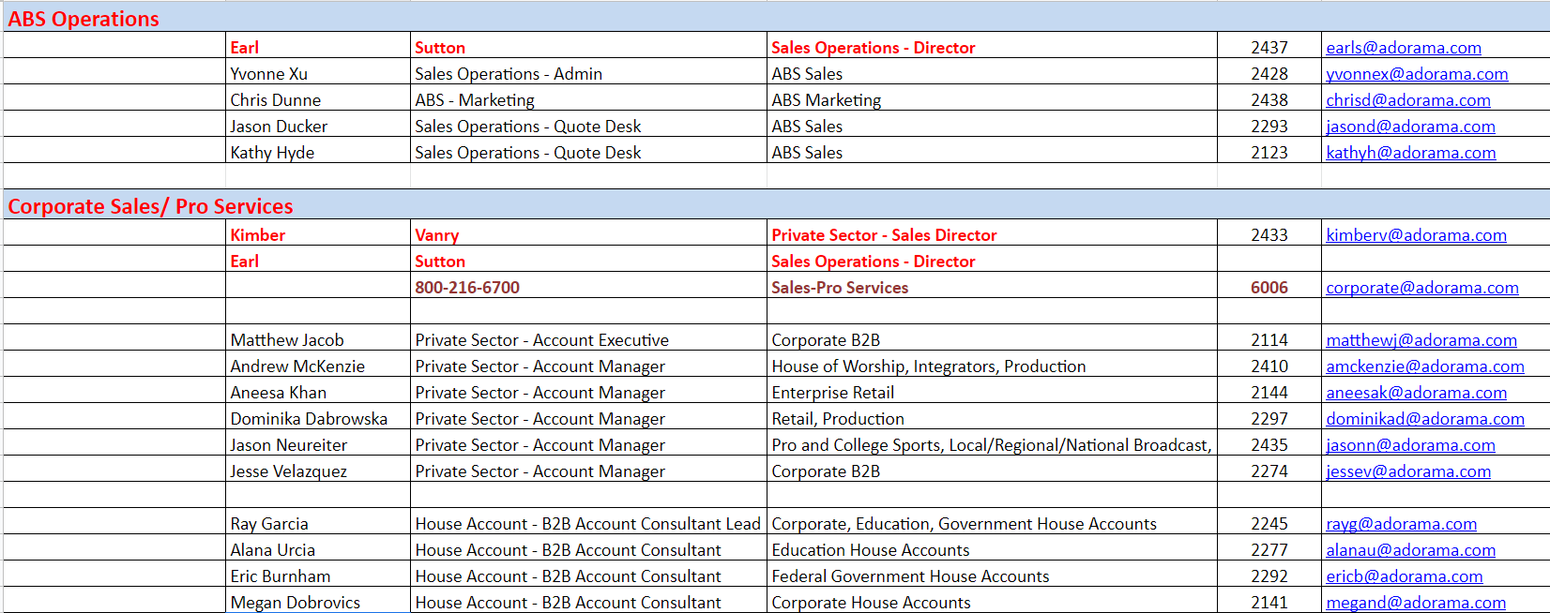
Who are the ABS Sales Team?

Slide 12


